Slide 1
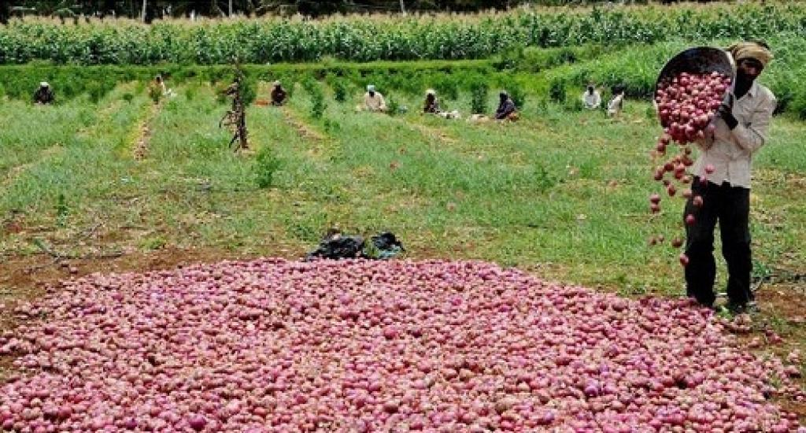
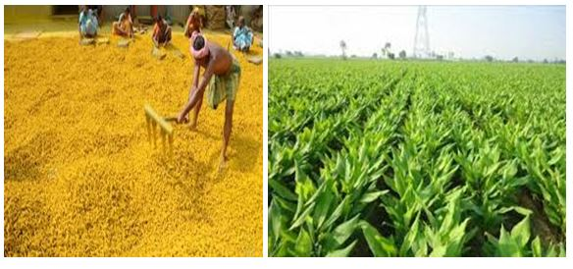
HARVEST GUARD more than a just security

Slide 2
Problem:
Burglary of harvested crops in the farm fields.
Identification of burglary and reporting have become a major issue today.

Slide 3
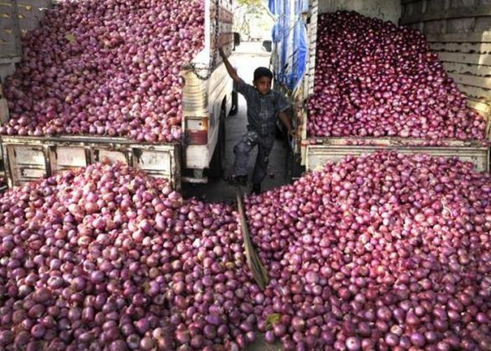
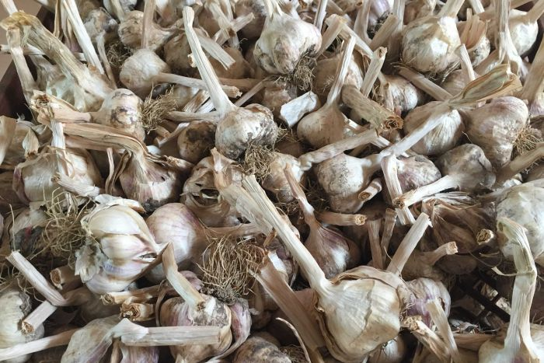
Problems occured:
Some quintals of onions were theft in Chhattisgarh which caused a lot of loss to a farmer.
Approximately 400 kilograms of garlic was stolen from a farm.

Slide 4
Traditional method used by farmers:
The farmers are habituated to protect their crop by staying at the fields over night.
But it may not always be possible to monitor for 24 by 7.

Slide 5
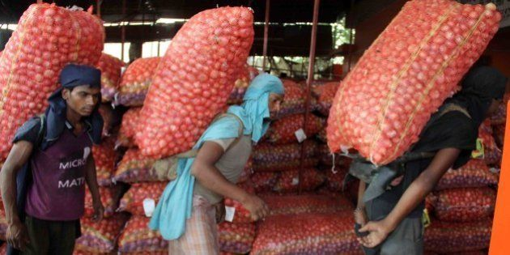

Our Solution:
A device which detects a person whether he is authorized or unauthorized in a specific area.
If the device detects an unauthorized person it makes sounds with a large alarm and an immediate message is sent to the owner.

Slide 6

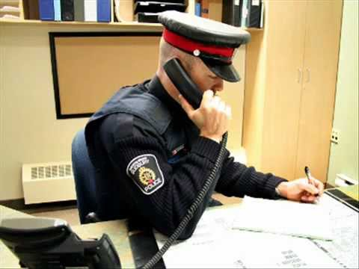
Visual of product : To help people to secure their goods
Provides security 24 by 7
Instant message to the police and the owner
Immediate alarm

Slide 7
Marketing plan:
Offline stores
Online stores like amazon , flipkart ,…..
We promote our product through advertisements like tv adds , news paper etc

Slide 8
Revenue model:
Cost of materials : 5000/-
Cost of labour : 100/-
Desired profit : 10% on each product – 510/-
Total cost (each product) – 6000/-

Slide 9
Financial plan:
Equity shares:5 lakhs
Loan under govt scheme:5 lakhs
Total expenses:1 lakhs
Start up total budget:10 lakhs
1st year revenue:5 lakhs
2nd year revenue : up to 10lakhs
3rd year revenue : up to 20 lakhs

Slide 10
Security Alert –Team:
B . Tejasri – CSE 3rd year
Parveen begum – CSE 3rd year
Rachuri.Ashwini – CSE 3rd year
P.Chandrika – CSE 3rd year

